Slide 1
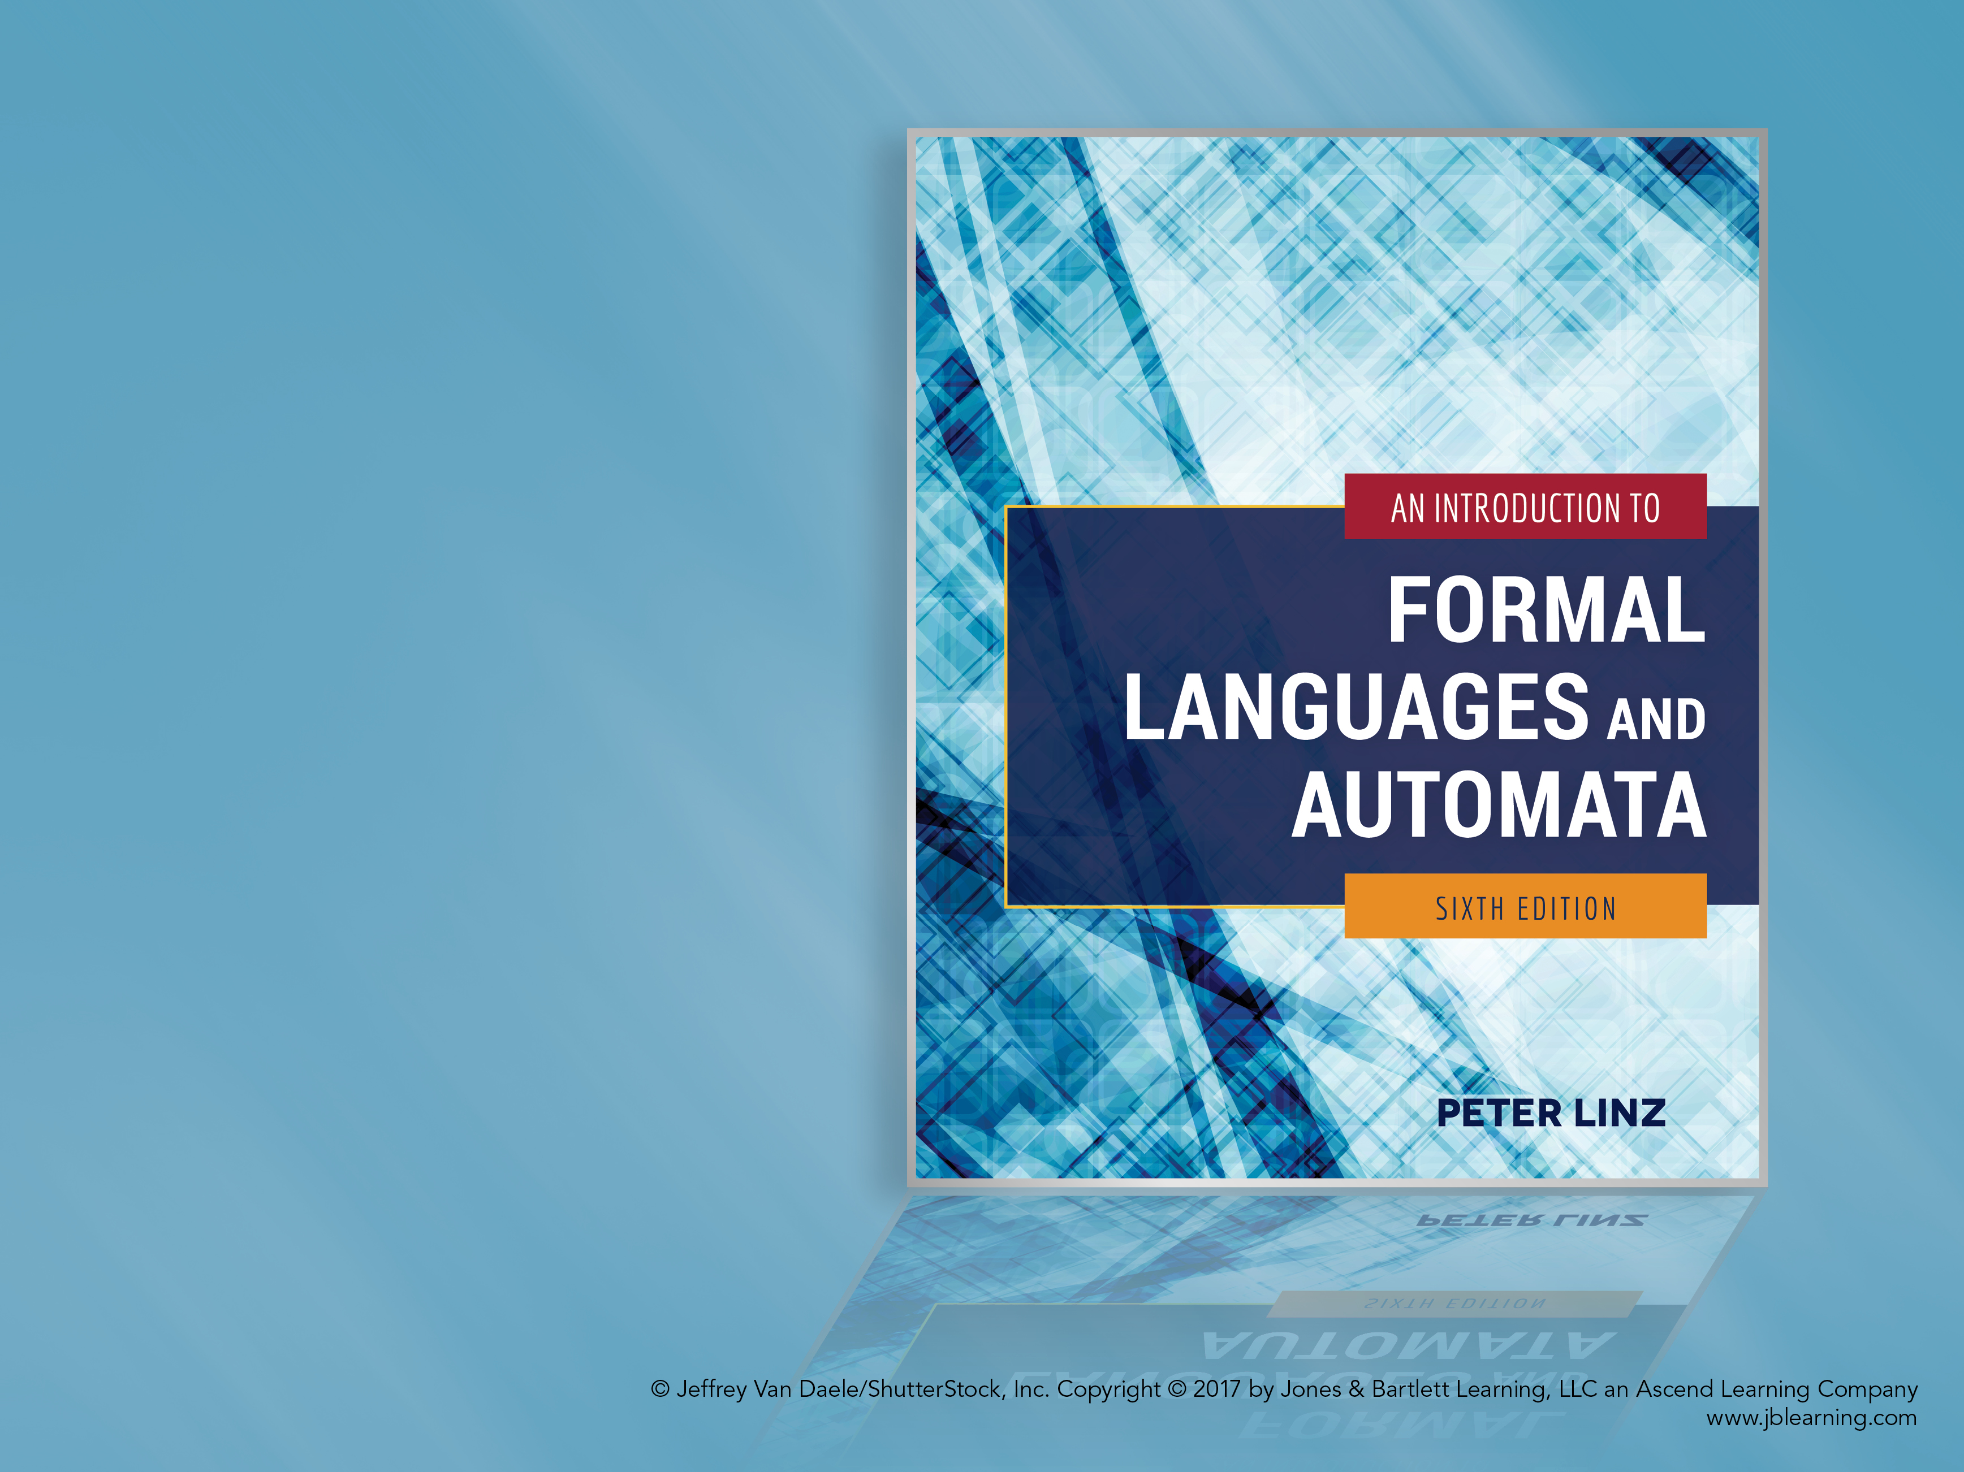
Chapter 1
INTRODUCTION TO THE THEORY OF COMPUTATION

Slide 2
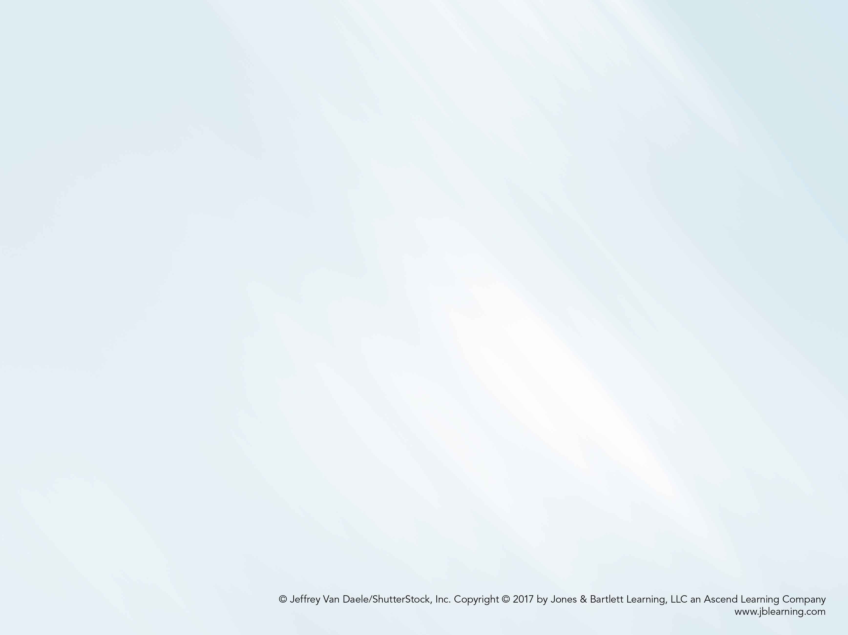
Learning Objectives At the conclusion of the chapter, the student will be able to:
Define the three basic concepts in the theory of computation: automaton, formal language, and grammar.
Solve exercises using mathematical techniques and notation learned in previous courses.
Evaluate expressions involving operations on strings.
Evaluate expressions involving operations on languages.
Generate strings from simple grammars.
Construct grammars to generate simple languages.
Describe the essential components of an automaton.
Design grammars to describe simple programming constructs.

Slide 3
Theory of Computation Basic Concepts
Automaton: a formal construct that accepts input, produces output, may have some temporary storage, and can make decisions
Formal Language: a set of sentences formed from a set of symbols according to formal rules
Grammar: a set of rules for generating the sentences in a formal language
In addition, the theory of computation is concerned with questions of computability (the types of problems computers can solve in principle) and complexity (the types of problems that can solved in practice).

Slide 4
Review of Mathematical Preliminaries
Sets: basic notation, operations (union, intersection, difference, and complementation), disjoint sets, power set, partitions.
Functions and Relations: domain, range, total function, partial function, order of magnitude, equivalence relations.
Graphs and Trees: vertices, edges, walk, path, simple path, cycle, loop, root vertex, parent, child, leaves, level, height.
Proof Techniques: proof by induction and proof by contradiction.

Slide 5
Formal Languages Basic Concepts
Alphabet: set of symbols, i.e. Σ = {a, b}
String: finite sequence of symbols from Σ, such as v = aba and w = abaaa
Empty string (λ)
Substring, prefix, suffix
Operations on strings:
Concatenation: vw = abaabaaa
Reverse: w^{R} = aaaba
Repetition: v² = abaaba and v⁰ = λ
Length of a string: |v| = 3 and |λ| = 0

Slide 6
Formal Languages Definitions
Σ* = set of all strings formed by concatenating zero or more symbols in Σ
Σ⁺ = set of all non-empty strings formed by concatenating symbols in Σ
In other words, Σ⁺ = Σ* - { λ }
A formal language is any subset of Σ*
Examples: L₁ = { a^{n}b^{n}: n ≥ 0 } and L₂ = { ab, aa }
A string in a language is also called a sentence of the language

Slide 7
Formal Languages Set Operations
A language is a set. Therefore, set operations are defined as usual.
If L₁ = { a^{n}b^{n}: n ≥ 0 } and L₂ = { ab, aa }
Union: L₁ ᴜ L₂ = { aa, λ, ab, aabb, aaabbb, … }
Intersection: L₁ ∩ L₂ = { ab }
Difference: L₁ - L₂ = { λ, aabb, aaabbb, … }
Complement: L₂ = Σ* - { ab, aa }
Practice: Find L₂ – L₁

Slide 8
Formal Languages Other Operations
New languages can be produced by reversing all strings in a language, concatenating strings from two languages, and concatenating strings from the same language.
If L₁ = { a^{n}b^{n}: n ≥ 0 } and L₂ = { ab, aa }
Reverse: L₂^{R} = { ba, aa }
Concatenation: L₁L₂ = { ab, aa, abab, abaa, aabbab, aabbaa, … }
The concatenation L₂L₂ or L₂² = { abab, abaa, aaab, aaaa }
Star-Closure: L₂* = L₂⁰ ᴜ L₂¹ ᴜ L₂² ᴜ L₂³ ᴜ …
Positive Closure: L₂⁺ = L₂¹ ᴜ L₂² ᴜ L₂³ ᴜ …
Practice: Find (L₂ – L₁)^{R}

Slide 9
Grammars Definition
Precise mechanism to describe the strings in a language
Def. 1.1: A grammar G consists of:
V: a finite set of variable or non-terminal symbols
T: a finite set of terminal symbols
S: a variable called the start symbol
P: a set of productions
Example 1.11:
V = { S }
T = { a, b }
P = { S → aSb, S → λ }

Slide 10
Grammars Derivation of Strings
Beginning with the start symbol, strings are derived by repeatedly replacing variable symbols with the expression on the right-hand side of any applicable production
Any applicable production can be used, in arbitrary order, until the string contains no variable symbols.
Sample derivation using grammar in Example 1.11:
S ⇒ aSb (applying first production)
⇒ aaSbb (applying first production)
⇒ aabb (applying second production)

Slide 11
The Language Generated by a Grammar
Def. 1.2: For a given grammar G, the language generated by G, L(G), is the set of all strings derived from the start symbol
To show a language L is generated by G:
Show every string in L can be generated by G
Show every string generated by L is in G
A given language can normally be generated by different grammars

Slide 12
Equivalence of Grammars
Two grammars are equivalent if they generate the same language
For convenience, productions with the same left-hand sides are written on the same line
Example 1.14:
V = { A, S }, T = { a, b }, and productions
S → aAb | λ
A → aAb | λ
The grammars in examples 1.11 and 1.14 can be shown to be equivalent

Slide 13
Automata
An automaton is an abstract model of a digital computer
An automaton consists of
An input mechanism
A control unit
Possibly, a storage mechanism
Possibly, an output mechanism
Control unit can be in any number of internal states, as determined by a next-state or transition function.

Slide 14
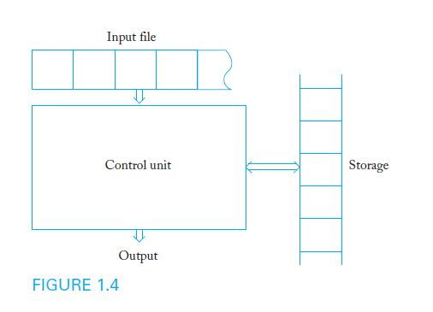
Diagram of a General Automaton

Slide 15
Application Grammars for Programming Languages
The syntax of constructs in a programming language is commonly described with grammars
Assume that in a hypothetical programming language,
Identifiers consist of digits and the letters a, b, or c
Identifiers must begin with a letter
Productions for a sample grammar:
<id> → <letter> <rest>
<rest> → <letter> <rest> | <digit> <rest> | λ
<letter> → a | b | c
<digit> → 0 | 1 | 2 | 3 | 4 | 5 | 6 | 7 | 8 | 9

